Slide 1
Introduction to Computer Networks
Network Connection Types
Network Topologies

Slide 2
Network Connection Types
Type of Connection
  Point to Point - single transmitter and receiver
  - is a direct link between two devices such as
  a computer and a printer.
  Multipoint - multiple recipients of single transmission
  - is a link between three or more devices.
1.<number>
Notes:
1.#

Slide 3

Figure 1.3 Types of connections: point-to-point and multipoint
1.<number>
Notes:
1.#

Slide 4
Network Topologies
Physical layout of nodes on a network
Network topology defines the layout, virtual shape, or structure of the network.
Topology defines the way hosts are connected to the network
1.<number>

Slide 5

Figure 1.4 Categories of topology
1.<number>
Notes:
1.#

Slide 6
Mesh
It is a point-to-point connection to other nodes or devices.
All the network nodes are connected to each other.
Mesh has n(n-1)/2 physical channels to link n devices.
n(n-1)/2 cable link are required for mesh
Full Duplex mode(2) : n(n-1)/2

Slide 7

Figure 1.5 A fully connected mesh topology (five devices)
1.<number>
Notes:
1.#

Slide 8
Advantages
Dedicated links –eliminating traffic problems
Privacy or security - If one link becomes unusable
Fault identification
1.<number>

Slide 9
Disadvantages
Amount of cabling – I/O ports
Expensive
Cable
1.<number>

Slide 10
POLL QUESTION
For 8 devices in a network, what is the number of cable links required for a mesh, topology?
1.<number>

Slide 11

A star topology connecting four stations
1.<number>
Notes:
1.#

Slide 12
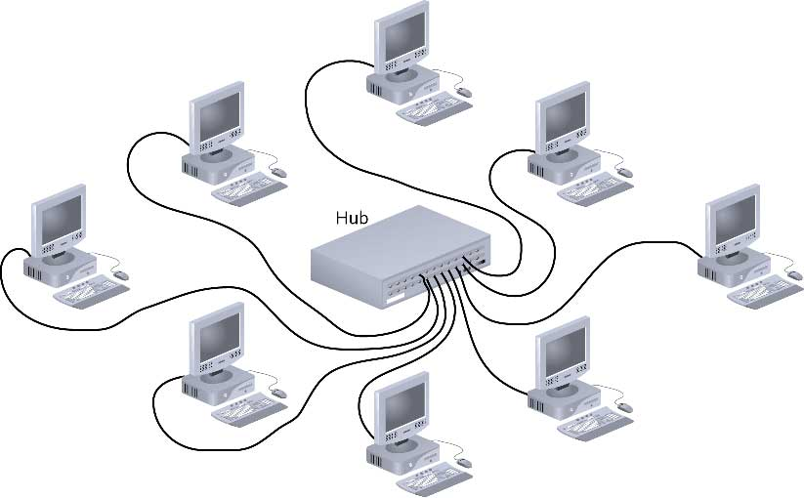
Star

Slide 13
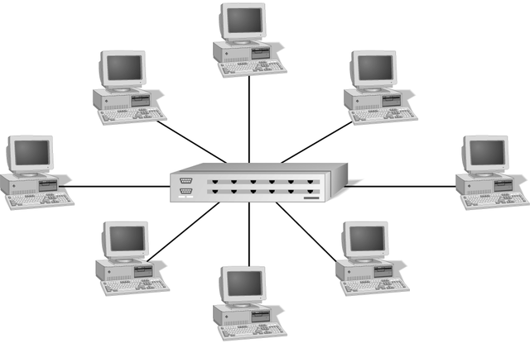
Simple Physical Topologies
Star topology
  Every node on the network is connected through a central device

Slide 14
Star (continued)
Any single cable connects only two devices
  Cabling problems affect two nodes at most
Requires more cabling than ring or bus networks
  More fault-tolerant
Easily moved, isolated, or interconnected with other networks
  Scalable
Supports max of 1024 addressable nodes on logical network

Slide 15
Advantages of Star Topology
Good option for modern networks
Low startup costs
Easy to manage
Offers opportunities for expansion
Most popular topology in use; wide variety of equipment available

Slide 16
Disadvantages of
Star Topology
Hub/Switch is a single point of failure
Requires more cable than the bus

Slide 17
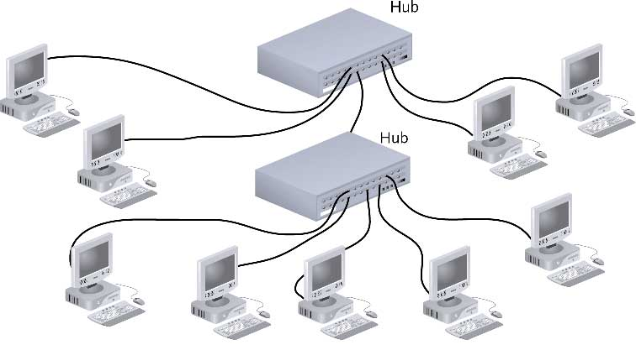
Star-Wired Bus

Slide 18
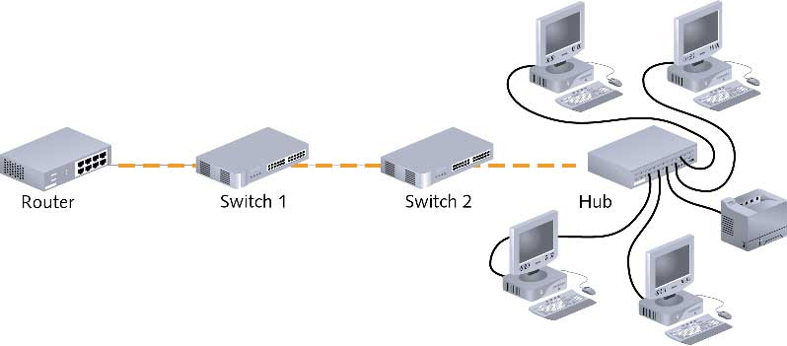
Backbone Networks: Serial Backbone (continued)

Slide 19
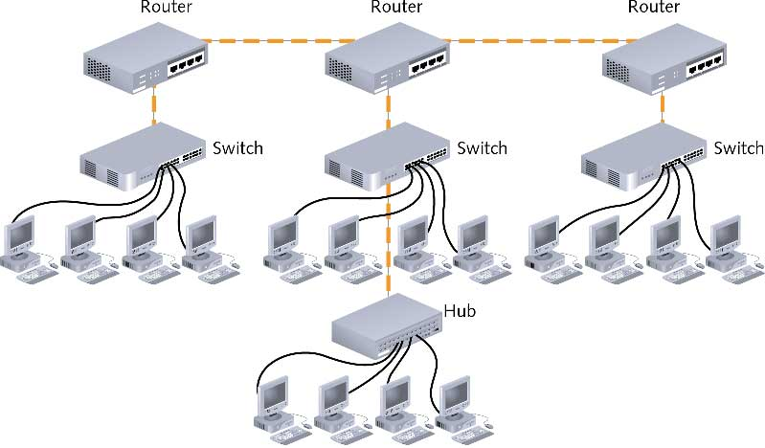
Distributed Backbone

Slide 20
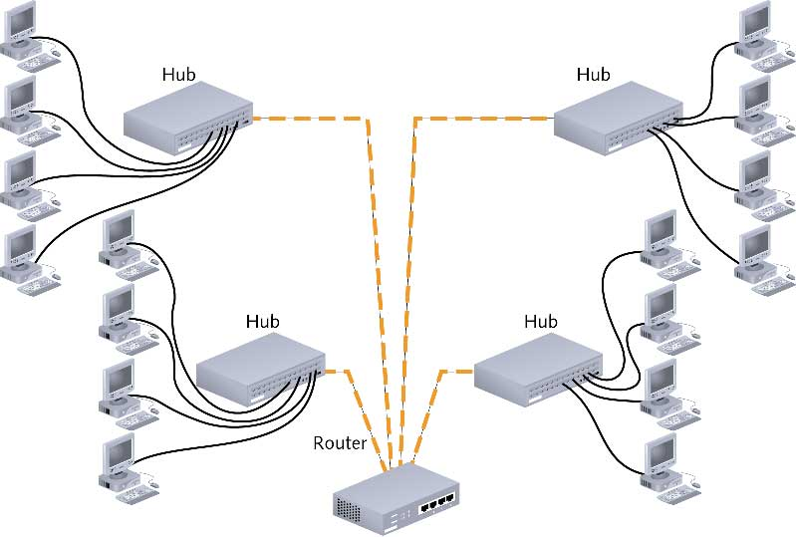
Collapsed Backbone

Slide 21
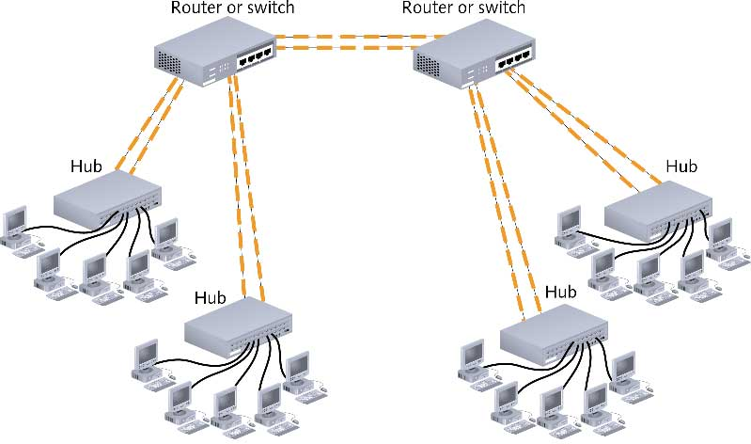
Parallel Backbone

Slide 22

A bus topology connecting three stations
1.<number>
Notes:
1.#

Slide 23
Bus
Single cable connects all network nodes without intervening connectivity devices
Devices share responsibility for getting data from one point to another
Terminators stop signals after reaching end of wire
  Prevent signal bounce
Inexpensive, not very scalable
Difficult to troubleshoot, not fault-tolerant

Slide 24
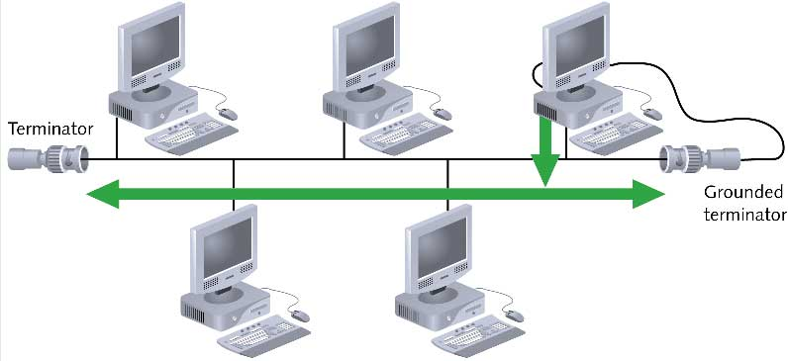
Bus (continued)

Slide 25
Advantages of Bus Topology
Works well for small networks
Relatively inexpensive to implement
Easy to add to it

Slide 26
Disadvantages of
Bus Topology
Management costs can be high
Potential for congestion with network traffic

Slide 27

A ring topology connecting six stations
1.<number>
Notes:
1.#

Slide 28
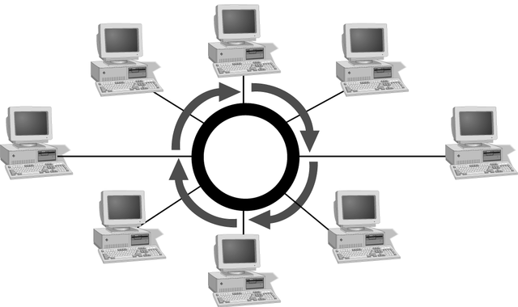
Simple Physical Topologies
Ring topology
  Each node is connected to the two nearest nodes so the entire network forms a circle
  One method for passing data on ring networks is token passing
Active topology
  Each workstation transmits data

Slide 29
Advantages of Ring Topology
Easier to manage; easier to locate a defective node or cable problem
Well-suited for transmitting signals over long distances on a LAN
Handles high-volume network traffic
Enables reliable communication

Slide 30
Disadvantages of
Ring Topology
Expensive
Requires more cable and network equipment at the start
Not used as widely as bus topology
  Fewer equipment options
  Fewer options for expansion to high-speed communication

Slide 31

Figure 1.9 A hybrid topology: a star backbone with three bus networks
1.<number>
Notes:
1.#

Slide 32
POLL 2
For n devices in a network, what is the number of cable links required for a mesh, ring, bus, and star topology?
1.<number>

Slide 33
Ans: n(n-1)/2 cable link are required for mesh, n for ring, n-1 cable link for bus, and n cable link for star topology.

Slide 34
Networks
Collection of computers and devices connected together
Used to transfer information or files, share resources, etc.
What is the largest network?
Characterized based on their geographical coverage, speed, capacities
Networks are categorized based on the following characteristics:
  Network coverage: LAN and WAN
  Network topologies: how the computers are connected together
Topology defines the way hosts are connected to the network

Slide 35
Two types of networks: LANs and WAN
A local area network (LAN) is usually privately owned and connects some hosts in a single office, building, or campus.
LANs use a smart connecting switch
which is able to recognize the destination address of the packet and guide the packet to its destination without sending it to all other hosts
1.<number>

Slide 36
LAN
It does not define the minimum or maximum number of hosts in a LAN
LAN using either a common cable or a switch.
to allow resources to be shared between the hosts
1.<number>

Slide 37
Wide Area Network
A wide area network (WAN) is also an interconnection of devices capable of communication.
WAN has a wider geographical span, spanning a town, a state, a country, or even the world
A LAN interconnects hosts; a WAN interconnects connecting devices such as switches, routers, or modems.
1.<number>

Slide 38
A LAN is normally privately owned by the organization that uses it;
a WAN is normally created and run by communication companies and leased by an organization that uses it
1.<number>

Slide 39
Types of WAN
point-to-point WANs and
switched WANs
1.<number>

Slide 40
Point-to-Point WAN
It is a network that connects two communicating devices through a transmission media (cable or air).
1.<number>

Slide 41
Switched WAN
A switched WAN is a network with more than two ends.
It is used in the backbone of global communication.
switched WAN is a combination of several point-to-point WANs that are connected by switches.
1.<number>

Slide 42

Figure 1.10 An isolated LAN connecting 12 computers to a hub in a closet
1.<number>
Notes:
1.#

Slide 43

Figure 1.11 WANs: a switched WAN and a point-to-point WAN
1.<number>
Notes:
1.#

Slide 44

Figure 1.12 A heterogeneous network made of four WANs and two LANs
1.<number>
Notes:
1.#

Slide 45
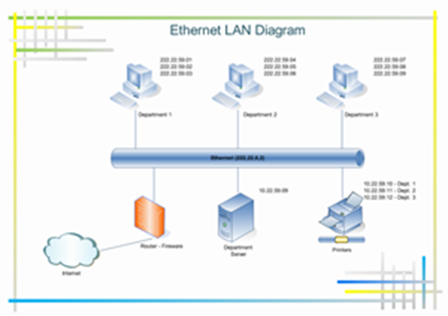
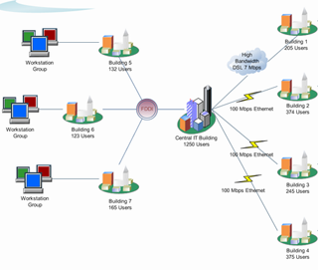

Slide 46
Internetwork
When two or more networks are connected, they make an internetwork, or internet
To make the communication between employees at different offices possible, the management leases a point-to-point dedicated WAN from a service provider, such as a telephone company, and connects the two LANs.
Now the company has an internetwork, or a private internet (with lowercase i).
1.<number>

Slide 47
Switching
An internet is a switched network in which a switch connects at least two links together.
A switch needs to forward data from a network to another network when required.
The two most common types of switched networks are circuit-switched and packet-switched networks
1.<number>

Slide 48
Network Criteria
Performance
  Measure in transit and response time
  Transit time- amount of time required for a message to travel from one device to another
  Response time- elapsed time between inquiry and a response
  ( to react to a given input)
  Measured in terms of Delay and Throughput
Reliability
  Measured by the frequency of failures,
  the time takes a link to recover from a failure
Security
  Data protection against corruption/loss of data due to:
      Errors
      Malicious users – protecting data from unauthorized access
1.<number>
Notes:
1.#

Slide 49
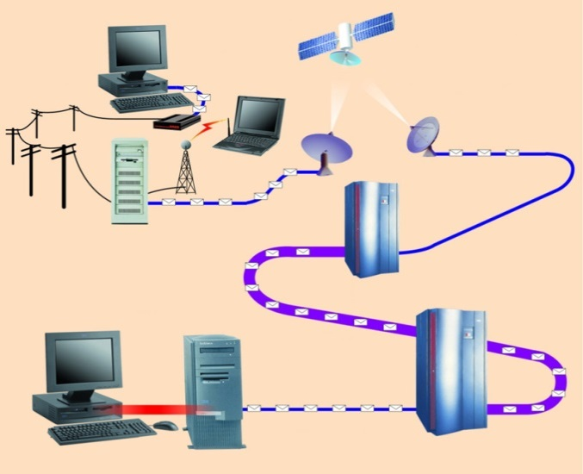
Communication Channels
A channel is a path between two communication devices
Channel capacity: How much data can be passed through the channel (bit/sec)
  Also called channel bandwidth
  The smaller the pipe the slower data transfer!
Consists of one or more transmission media
  Materials carrying the signal
  Two types:
    Physical: wire cable
    Wireless: Air
T1 lines
T1 lines
destination network server
T3 lines
T1 lines

Slide 50
Bandwidth & Throughput
Bandwidth is the maximum amount of data that can travel through a 'channel'.
Throughput is how much data actually does travel through the 'channel' successfully.
channel is the number of bits it can transfer per second
1.<number>
Notes:
1.#

Slide 51
delay
The delay of a network specifies how long it takes for a bit of data to travel across the network from one node or endpoint to another.
It is typically measured in multiples or fractions of seconds.
1.<number>

Slide 52
1-4 PROTOCOLS
It consists of a set of rules that govern data communications.
It determines
what is communicated,
how it is communicated and
when it is communicated.
The key elements of a protocol are
syntax,
semantics and
timing
1.<number>
Notes:
1.#

Slide 53
_x0010_Elements of a Protocol
Syntax
  Structure or format of the data
  Indicates how to read the bits - field delineation
Semantics
  the meaning of each section of bits
  Knows which fields define what action
Timing
  When data should be sent and what
  Speed at which data should be sent or speed at which it is being received.
1.<number>
Notes:
1.#

Slide 54
Standards
Creating and maintaining an open and competitive market for equipment
To provide guidelines to manufacturer , vendors and government agencies
Two categories:
1. De facto – not approved by an
organized body but adopted
2. De jure – officially recognized
1.<number>

Slide 55
Standards organizations
ISO – International organization for
standardization
ITU-T – International Telecommunication
union
ANSI
IEEE
EIA
1.<number>

Slide 56
Internet
Network is a group of connected communicating devices
internet- two or more networks that can communicate with each other.
Internet – a collaboration of more than hundreds of thousands of interconnected networks
ARPA – Advanced Research Projects Agency
1.<number>

Slide 57

Figure 1.13 Hierarchical organization of the Internet
ISP – internet
connection use
service
1.<number>
Notes:
1.#

Slide 58
Internet Connections
Internet backbone A set of high-speed networks that carry Internet traffic
These networks are provided by companies such as AT&T, GTE, and IBM
Internet service provider (ISP) A company that provides other companies or individuals with access to the Internet
15-<number>

Slide 59
Internet Connections
There are various technologies available that you can use to connect a home computer to the Internet
  A phone modem converts computer data into an analog audio signal for transfer over a telephone line, and then a modem at the destination converts it back again into data
  A digital subscriber line (DSL) uses regular copper phone lines to transfer digital data to and from the phone company’s central office
  A cable modem uses the same line that your cable TV signals come in on to transfer the data back and forth
15-<number>

Slide 60
Internet Connections
Broadband A connection in which transfer speeds are faster than 128 bits per second
  DSL connections and cable modems are broadband connections
  The speed for downloads (getting data from the Internet to your home computer) may not be the same as uploads (sending data from your home computer to the Internet)
15-<number>

Slide 61
Networking
The generic term node or host refers to any device on a network
Data transfer rate The speed with which data is moved from one place on a network to another
Data transfer rate is a key issue in computer networks
15-<number>

Slide 62
Understanding the Data Rate Units
Unit | Symbol | Description
bits per second | bps or b/s or bit/s
Kilobits per second | Kbps or kb/s or kbit/s | 1 Kbps = 1,000 bps
Megabits per second | Mbps or Mb/s or Mbit/s | 1 Mbps = 1,000 Kbps
Gigabits per second | Gbps or Gb/s or Gbit/s | 1 Gbps = 1,000 Mbps
Terabits per second | Tbps or Tb/s or Tbit/s | 1 Tbps = 1,000 Gbps
Petabits per second | Pbps or Pb/s or Pbit/s | 1 Pbps = 1,000 Tbps
Bytes per second | Bps or B/s | 1 Bps = 8 bps
Kilobytes per second | KBps or KB/s | 1 KBps = 1,000 Bps
Megabytes per second | MBps or MB/s | 1 MBps = 1,000 KBps
Gigabytes per second | GBps or GB/s | 1 GBps = 1,000 MBps
Terabytes per second | TBps or TB/s | 1 TBps = 1,000 GBps
Petabytes per second | PBps or PB/s | 1 PBps = 1,000 TBps
1.<number>

Slide 63
1 KB | 1 KiloByte | (1 KB = 1,024 Bytes = 8,192 bits ) [1 Byte = 8 bits. 1,024 Bytes = 1 KiloByte (1 KB); therefore 1 KB is 8,192 bits ( 1*1,024 Bytes*8 = 8,192 ).]
1 kb | 1 kilobit | (1 kilobit = 1,000 bits)
1 MB | 1 MegaByte (filesize) | (1 MegaByte = 1,048,576 Bytes = 1,024 KiloBytes)
1 mb | 1 megabit | (1 megbit = 1,000,000 bits [one million bits] = 1,000 kb) [*4]
1 mbps or 1 Mbps | (bitrate) | "1 million bits per second", or "1 megabit every second".
1 GB | 1 GigaByte | (1,073,741,824 Bytes) [*4] (also used: "gig").
1 BB | 1 billion Bytes | (1,000,000,000 Bytes) "BB" is an alternative to "GB" for base-10; hard drives and DVDs say "GB" when the values are actually in BB [*1]
1 KB/s |  | "The ratio of one KiloByte to one second." i.e. "One KiloByte per second."
1 kbps |  | "One kilobit per second."
Bytes → big "B"; bits → small "b".
When talking about storage, think Bytes, not bits.
When talking about data transfer, use bits, not Bytes.

Slide 64
Applications and layered architectures
Various services: various applications require various services
Flexibility: powerful networks need to be flexible enough to support the current services and future services
Architectures: an overall network architecture is necessary to achieve the flexibility

Slide 65
Layered architectures
Layers: grouping the common functions
Benefits of layers:
  Simplicity: easy to design once layers and their interaction are defined clearly
  Flexibility: easy to modify and develop networks by separate layers modifications
  Incremental changes: add new layers, add new functions to a layer

Slide 66
Three obvious tasks (layers)
Transport of data across the network from one end to the other
Routing/forwarding of packets across multiple hops
Transfer of a frame from one interface to another (i.e., one hop).

Slide 67
Big picture of layered architectures
Web browsing and e-mail examples
OSI reference model (Seven layers)
TCP/IP architecture
Detailed end-to-end examples to complete big picture of layered architectures
Socket API and other utilities

Slide 68
Terminology
Client/Server model: the most typical interaction between two parties within networks
Client: the process making requests
Server (Daemon): the process waiting and receiving requests, processing the requests and returning results
Protocols: a set of rules governing how two communicating parties are to interact.
Service: a protocol will provide a service
Layers’ protocols: each layer carries out a specific set of functions using its own protocol, and builds on the services of the layer below it (provides a service to its upper layer).

